Slide 1
EE455 Introduction to Energy Distribution Systems
ECpE Department
Dr. Zhaoyu Wang
1113 Coover Hall, Ames, IA
wzy@iastate.edu

Slide 2
Distribution Feeder Modeling
and Analysis
Acknowledgement: The slides are developed based in part on Distribution System Modeling and Analysis, 4th edition, William H. Kersting, CRC Press, 2017

Slide 3
Distribution Feeder Analysis
The analysis of a distribution feeder will typically consist of a study of the feeder under normal steady-state operating conditions (power-flow analysis) and a study of the feeder under short-circuit conditions (short-circuit analysis).
Both analyses are performed in phase frame.
Models of all of the components of a distribution feeder have been developed in previous chapters. These models will be applied for the analysis under steady-state and short-circuit conditions.
ECpE Department

Slide 4
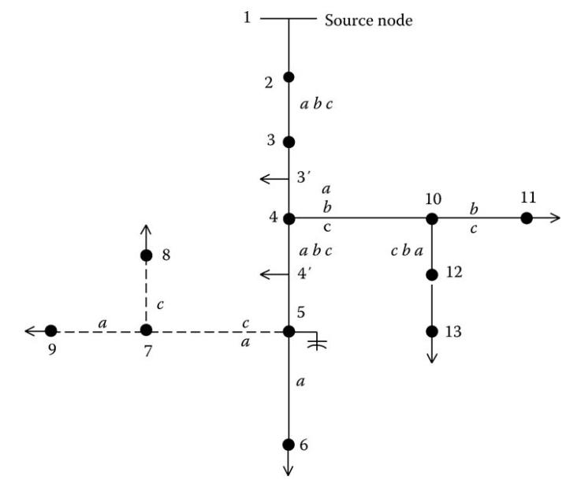
General Feeder Modeling - Series Components
A typical distribution feeder consists of the primary main with laterals tapped off the primary main and sub-laterals tapped off the laterals.
A distribution feeder can be broken into the “series” components and the “shunt” components. These series components can be lines, transformers, voltage regulators...
Fig. 2 is a general model of series component; no distinction is made as to what type of element is connected between nodes.
Fig.2 Standard feeder series component model
Fig.1 A typical unbalanced distribution feeder
ECpE Department

Slide 5
General Feeder Modeling - Series Components
 | $$△− Grounded Y$$ Step-down | Wye-Connected Voltage Regulator | Line Segment
$$[a]$$ | $$−\frac{n_{t}}{3}\left[\begin{matrix}0 & 2 & 1 \\ 1 & 0 & 2 \\ 2 & 1 & 0\end{matrix}\right]$$ | $$\left[\begin{matrix}a_{R_a} & 0 & 0 \\ 0 & a_{R_b} & 0 \\ 0 & 0 & a_{R_c}\end{matrix}\right]$$ | $$[u]$$
$$[b]$$ | $$−\frac{n_{t}}{3}\left[\begin{matrix}0 & 2Z_{t_{b}} & Z_{t_{c}} \\ Z_{t_{a}} & 0 & 2Z_{t_{c}} \\ 2Z_{t_{a}} & Z_{t_{b}} & 0\end{matrix}\right]$$ | $$\left[\begin{matrix}0 & 0 & 0 \\ 0 & 0 & 0 \\ 0 & 0 & 0\end{matrix}\right]$$ | $$[Z_{abc}]$$
$$[c]$$ | $$\left[\begin{matrix}0 & 0 & 0 \\ 0 & 0 & 0 \\ 0 & 0 & 0\end{matrix}\right]$$ | $$\left[\begin{matrix}0 & 0 & 0 \\ 0 & 0 & 0 \\ 0 & 0 & 0\end{matrix}\right]$$ | $$\left[\begin{matrix}0 & 0 & 0 \\ 0 & 0 & 0 \\ 0 & 0 & 0\end{matrix}\right]$$
$$[d]$$ | $$\frac{1}{n_{t}}\left[\begin{matrix}1 & −1 & 0 \\ 0 & 1 & −1 \\ −1 & 0 & 1\end{matrix}\right]$$ | $$\left[\begin{matrix}{1/a}_{R_a} & 0 & 0 \\ 0 & {1/a}_{R_b} & 0 \\ 0 & 0 & {1/a}_{R_c}\end{matrix}\right]$$ | $[u$]
$$[A]$$ | $$\frac{1}{n_{t}}\left[\begin{matrix}1 & 0 & −1 \\ −1 & 1 & 0 \\ 0 & −1 & 1\end{matrix}\right]$$ | $$\left[\begin{matrix}{1/a}_{R_a} & 0 & 0 \\ 0 & {1/a}_{R_b} & 0 \\ 0 & 0 & 1/a_{R_c}\end{matrix}\right]$$ | $$[u\text{]}$$
$$[B]$$ | $$\left[\begin{matrix}Z_{t_{a}} & 0 & 0 \\ 0 & Z_{t_{b}} & 0 \\ 0 & 0 & Z_{t_{c}}\end{matrix}\right]$$ | $$\left[\begin{matrix}0 & 0 & 0 \\ 0 & 0 & 0 \\ 0 & 0 & 0\end{matrix}\right]$$ | $$[Z_{abc}]$$
 | $$n_{t}=\frac{VLL_{rated primary}}{VLN_{rated secondary}}$$ | $a_{R}=1±0$.00625$∙$Tap
${\left[{VLG}_{abc}\right]}_{m}$=$[A]{∙\left[{VLG}_{abc}\right]}_{n}$ $− \left[B\right]∙{\left[I_{abc}\right]}_{m}$
${\left[I_{abc}\right]}_{n}$=$[c]{∙\left[{VLG}_{abc}\right]}_{m}$+$[d]{∙\left[I_{abc}\right]}_{m}$
${\left[{VLG}_{abc}\right]}_{n}$=$[a]{∙\left[{VLG}_{abc}\right]}_{m}$ $+ \left[b\right]{∙\left[I_{abc}\right]}_{m}$

Slide 6
General Feeder Modeling - Series Components
With reference to Fig.3, for any series components, they are modeled using the following two equations.
These two equations are also known as forward and backward sweep models.
Forward sweep:
$${[{VLN}_{abc}]}_{m}=\left[A\right]{∙[{VLN}_{abc}]}_{n}−\left[B\right]{∙[I_{abc}]}_{n}$$
(1)
Backward sweep:
$${[I_{abc}]}_{n}=\left[c\right]{∙[{VLN}_{abc}]}_{m}+\left[d\right]{∙[I_{abc}]}_{m}$$
(2)
For different components, the equations have the same format, and [A], [B], [c], and [d] are all 3 × 3 matrices. However, calculating the components in these matrices will be different for different components.
For example, Carson's equations can be used for computing the line impedances for overhead and underground lines [Chapter 4, Kersting]. Two-phase and single-phase lines are represented by a 3 × 3 matrix with zeros set in the rows and columns of the missing phases.
In most cases, the [c] matrix will be zero. Long underground lines will be an exception.
Fig.3 Standard feeder series component model
ECpE Department

Slide 7
General Feeder Modeling - Shunt Components
The shunt components of a distribution feeder are
Spot static loads
Spot induction machines
Capacitor banks
Spot static loads are located at a node and can be three phase, two phase, or single phase and connected in either a wye or a delta connection. The loads can be modeled as constant complex power, constant current, constant impedance, or a combination of the three.
Note in Fig. 1 that the line between nodes 3 and 4 and between nodes 4 and 5 have “distributed” loads modeled at the middle of the lines. Connecting the loads at the center was only one of three ways to model the load. A second method is to place one-half of the load at each end of the line. The third method is to place two-thirds of the load 25% of the way down the line from the source end. The remaining one-third of the load is connected at the receiving end node. This “exact” model gives the correct voltage drop down the line in addition to the correct power line power loss.
ECpE Department

Slide 8
General Feeder Modeling - Shunt Components
A spot induction machine is modeled using the shunt admittance matrix. The machine can be modeled as a motor with a positive slip or as an induction generator with a negative slip.
The input power (positive for a motor and negative for a generator) can be specified and the required slip computed using the iterative process (See Chapter 9, Kersting).
Capacitor banks are located at a node and can be three phase, two phase, or single phase and can be connected in a wye or delta. Capacitor banks are modeled as constant admittances (See Chapter 9, Kersting).
ECpE Department

Slide 9
Why Modeling - Power-Flow Analysis
The previously developed models will be used in the power-flow analysis of a distribution feeder.
The power-flow analysis of a distribution feeder is similar to that of an interconnected transmission system. Typically, what will be known prior to the analysis will be the three-phase voltages at the substation and the complex power of all of the loads and the load model (constant complex power, constant impedance, constant current, or a combination). Sometimes, the input complex power supplied to the feeder from the substation is also known.
A power-flow analysis of a feeder can determine the following:
Voltage magnitudes and angles at all nodes of the feeder
Line flow in each line section specified in kW and kvar, amps and degrees, or amps and power factor
Power loss in each line section
Total feeder input kW and kvar
Total feeder power losses
Load kW and kvar based upon the specified model for the load
ECpE Department

Slide 10
Modified “Ladder” Iterative Technique
Because a distribution feeder is radial, iterative techniques commonly used in transmission network power-flow studies are not used because of poor convergence characteristics [1]. Instead, an iterative technique specifically designed for a radial system is used.
When the source voltages are specified and the loads are specified as constant kW and kvar (constant PQ), the system becomes nonlinear, and an iterative method will have to be used to compute the load voltages and currents. Chapter 10 develops in detail the modified “ladder” iterative technique. However, a simple form of that technique will be developed here in order to demonstrate how the nonlinear system can be evaluated.
The ladder technique is composed of two parts:
Forward sweep
Backward sweep
The forward sweep computes the downstream voltages from the source by applying Equation (26):
${\left[{VLG}_{abc}\right]}_{m}$=$[A]{∙\left[{VLG}_{abc}\right]}_{n}$ $− \left[B\right]∙{\left[I_{abc}\right]}_{n}$
(26)
[1] Trevino, C., Cases of difficult convergence in load-flow problems, IEEE Paper no. 71-62-PWR, Presented at the IEEE Summer Power Meeting, Los Angeles, CA, 1970.
ECpE Department

Slide 11
Modified “Ladder” Iterative Technique
${\left[{VLG}_{abc}\right]}_{m}$=$[A]{∙\left[{VLG}_{abc}\right]}_{n}$ $− \left[B\right]∙{\left[I_{abc}\right]}_{n}$
(26)
To start the process, the load currents [I_{abc}] are assumed to be equal to zero and the load voltages are computed. In the first iteration the load voltages will be the same as the source voltages.
The backward sweep computes the currents from the load back to the source using the most recently computed voltages from the forward sweep. Equation (16a) is applied for this sweep:
${\left[I_{abc}\right]}_{n}$=$[c]{∙\left[{VLG}_{abc}\right]}_{m}$+$[d]{∙\left[I_{abc}\right]}_{m}$
(16a)
Recall that for all practical purposes the [c] matrix is zero so Equation (16a) is simplified to be
${\left[I_{abc}\right]}_{n}$=$[d]{∙\left[I_{abc}\right]}_{m}$
(16b)
After the first forward and backward sweeps, the new load voltages are computed using the most recent currents. Also, the load/shunt device currents should be updated using the most recent voltages before moving to backward sweep. The forward and backward sweeps continue until the error between the new and previous load voltages is within a specified tolerance.
ECpE Department

Slide 12
Modified “Ladder” Iterative Technique
With reference to Fig.5, nodes 4, 10, 5, and 7 are referred to as “junction nodes.” In both the forward and backward sweeps, the junction nodes must be recognized. In the forward sweep, the voltages at all nodes down the lines from the junction nodes must be computed. In the backward sweeps, the currents at the junction nodes must be summed before proceeding toward the source.
The “node” currents may be three phase, two phase, or single phase and consist of the sum of the spot load currents and one-half of the distributed load currents (if any) at the node plus the capacitor current (if any) at the node. It is possible that at a given node the distributed load can be one-half of the distributed load in the “from” segment plus one-half of the distributed load in the “to” segment.
Fig.5 Typical distribution feeder
ECpE Department

Slide 13
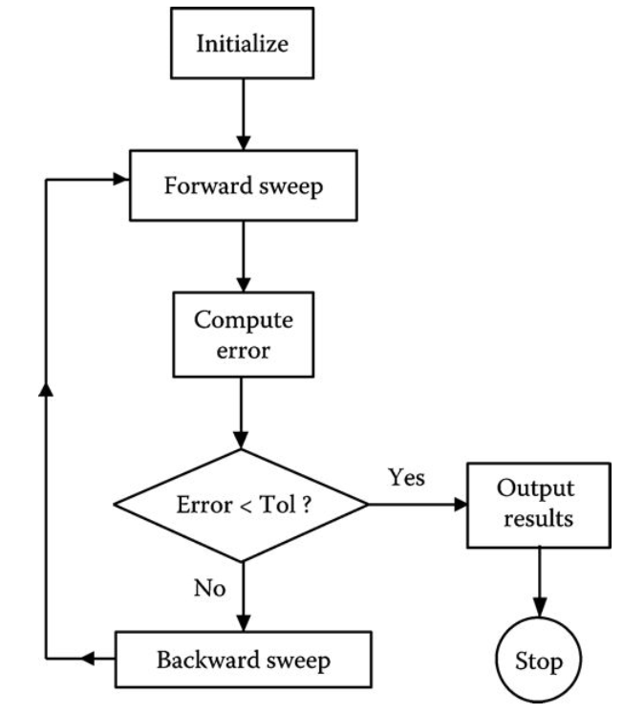
Modified “Ladder” Iterative Technique
A simple flowchart of the program that is used in other chapters is shown in Fig.6.
Fig.6 Simple modified ladder flowchart
ECpE Department

Slide 14
Applying the Modified Ladder Iterative Technique
We have outlined the steps required for the application of the ladder iterative technique. Forward and backward sweep matrices have been developed for the series devices. By applying these matrices, the computation of the voltage drops along a segment will always be the same regardless of whether the segment represents a line, voltage regulator, or transformer.
In the preparation of data for a power-flow study, it is extremely important that the impedances and admittances of the line segments are computed using the exact spacings and phasing. Because of the unbalanced loading and resulting unbalanced line currents, the voltage drops due to the mutual coupling of the lines become very important. It is not unusual to observe a voltage rise on a lightly loaded phase of a line segment that has an extreme current unbalance.
ECpE Department

Slide 15
Applying the Modified Ladder Iterative Technique
The real power loss in a device can be computed in two ways.
The first method is to compute the power loss in each phase by taking the phase current squared times the total resistance of the phase. Care must be taken to not use the resistance value from the phase impedance matrix. The actual phase resistance that was used in Carson's equations must be used. In developing a computer program, calculating power loss this way requires that the conductor resistance is stored in the active data base for each line segment.
Unfortunately, this method does not give the total power loss in a line segment since the power loss in the neutral conductor and ground are not included. In order to determine the losses in the neutral and ground, we must compute the neutral and ground currents and then the power losses.
ECpE Department

Slide 16
Applying the Modified Ladder Iterative Technique
A second, and preferred, method is to compute power loss as the difference between the real power into a line segment and the real power output of the line segment. Because the effects of the neutral conductor and ground are included in the phase impedance matrix of the total power loss, this method will give the same results as mentioned earlier where the neutral and ground power losses are computed separately.
This method can lead to some interesting numbers for very unbalanced line flows in that it is possible to compute what appears to be a negative phase power loss. This is a direct result of the accurate modeling of the mutual coupling between phases. Remember that the effect of the neutral conductor and the ground resistance is included in Carson's equations.
In reality, there can not be a negative phase power loss. Using this method, the algebraic sum of the line power losses will equal the total three-phase power loss that were computed using the current squared times resistance for the phase and neutral conductors along with the ground current.
ECpE Department

Slide 17
Let’s Put It All Together
At this point the models for all components of a distribution feeder have been developed. The modified ladder iterative technique has also been developed. It is time to put them all together and demonstrate the power-flow analysis of a very simple system. The example below will demonstrate how the models of the components work together in applying the modified ladder technique to achieve a final solution of the operating characteristics of an unbalanced feeder.
ECpE Department

Slide 18
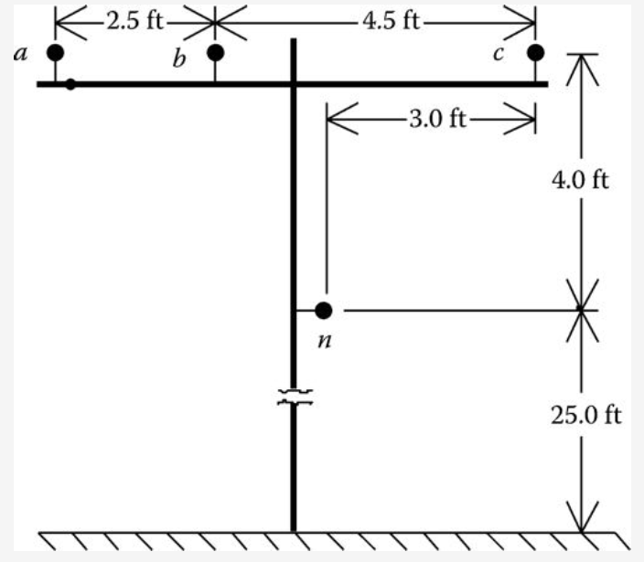
Example
A very simple distribution feeder is shown in Figure 7.
For the system in Fig.7, the infinite bus voltages are balanced three phase of 12.47 kV line to line. The “source” line segment from node 1 to node 2 is a three-wire delta 2000 ft long line and is constructed on the pole configuration of as shown without the neutral. The “load” line segment from node 3 to node 4 is 2500 ft long and also is constructed on the pole configuration as shown but is a four-wire wye so the neutral is included. Both line segments use 336,400 26/7 ACSR phase conductors and the neutral conductor on the four-wire wye line is 4/0 6/1 ACSR. Since the lines are short, the shunt admittance will be neglected. The 25°C resistance is used for the phase and neutral conductors:
$$336,400{26}/7ACSR:resistance at 25℃=0.278 Ω/mile$$
$$4/06/1ACSR:resistance at 25℃=0.445 Ω/mile$$
Fig.7 Example feeder
ECpE Department

Slide 19
Example
The phase impedance matrices for the two line segments are
$\left[{ZeqS}_{ABC}\right]=\left[\begin{matrix}0.1414+j0.5353 & 0.0361+j0.3225 & 0.0361+j0.2572 \\ 0.0361+j0.3225 & 0.1414+j0.5353 & 0.0361+j0.2955 \\ 0.0361+j0.2572 & 0.0361+j0.2955 & 0.1414+j0.5353\end{matrix}\right]$ $Ω$
$\left[{ZeqL}_{abc}\right]=\left[\begin{matrix}0.1907+j0.5035 & 0.0607+j0.2302 & 0.0598+j0.1751 \\ 0.0607+j0.2302 & 0.1939+j0.4885 & 0.0614+j0.1931 \\ 0.0598+j0.1751 & 0.0614+j0.1931 & 0.1921+j0.4970\end{matrix}\right]$ $Ω$
The transformer bank is connected delta–grounded wye and consists of three single-phase transformers each rated:
$$2000 kVA, 12.47−2.4 kV, Z=1.0+j6.0\%$$
The feeder serves an unbalanced three-phase wye-connected constant PQ load of
$$S_{a}=750 kVA at 0.85 lagging power factor$$
$$S_{b}=1000 kVA at 0.90 lagging power factor$$
$$S_{c}=1230 kVA at 0.95 lagging power factor$$
ECpE Department

Slide 20
Example
Before starting the iterative solution, the forward and backward sweep matrices must be computed for each series element. The modified ladder method is going to be employed so only the [A], [B], and [d] matrices need to be computed.
Source line segment with shunt admittance neglected:
[$U$]=$\left[\begin{matrix}1 & 0 & 0 \\ 0 & 1 & 0 \\ 0 & 0 & 1\end{matrix}\right]$
$\left[A_{1}\right]=$[$U$]=$\left[\begin{matrix}1 & 0 & 0 \\ 0 & 1 & 0 \\ 0 & 0 & 1\end{matrix}\right]$
$$\left[B_{1}\right]=\left[{ZeqS}_{ABC}\right]=\left[\begin{matrix}0.1414+j0.5353 & 0.0361+j0.3225 & 0.0361+j0.2572 \\ 0.0361+j0.3225 & 0.1414+j0.5353 & 0.0361+j0.2955 \\ 0.0361+j0.2572 & 0.0361+j0.2955 & 0.1414+j0.5353\end{matrix}\right]$$
$\left[d_{1}\right]=$[$U$]=$\left[\begin{matrix}1 & 0 & 0 \\ 0 & 1 & 0 \\ 0 & 0 & 1\end{matrix}\right]$
ECpE Department

Slide 21
Example
Load line segment:
$\left[A_{2}\right]=$[$U$]=$\left[\begin{matrix}1 & 0 & 0 \\ 0 & 1 & 0 \\ 0 & 0 & 1\end{matrix}\right]$
$$\left[B_{2}\right]=\left[{ZeqL}_{abc}\right]=\left[\begin{matrix}0.1907+j0.5035 & 0.0607+j0.2302 & 0.0598+j0.1751 \\ 0.0607+j0.2302 & 0.1939+j0.4885 & 0.0614+j0.1931 \\ 0.0598+j0.1751 & 0.0614+j0.1931 & 0.1921+j0.4970\end{matrix}\right]$$
$\left[d_{2}\right]=$[$U$]=$\left[\begin{matrix}1 & 0 & 0 \\ 0 & 1 & 0 \\ 0 & 0 & 1\end{matrix}\right]$
ECpE Department

Slide 22
Example
Transformer:
The transformer impedance must be converted to actual value in Ohms referenced to the low-voltage windings.
$$Z_{base}=\frac{{2.4}^{2}∙1000}{2000}=2.88 Ω$$
${Zt}_{low}=(0.01+j0.06)∙2.88$ $=0.0288+j0.1728 Ω$
The transformer phase impedance matrix is
$$\left[{Zt}_{abc}\right]=\left[\begin{matrix}0.0228+j0.1728 & 0 & 0 \\ 0 & 0.0228+j0.1728 & 0 \\ 0 & 0 & 0.0228+j0.1728\end{matrix}\right]$$
ECpE Department

Slide 23
Example
The “turns” ratio: n_{t} = 12.47/2.4 = 5.1958.
$$\left[A_{t}\right]=\frac{1}{n_{t}}∙\left[\begin{matrix}1 & 0 & −1 \\ −1 & 1 & 0 \\ 0 & −1 & 1\end{matrix}\right]=\left[\begin{matrix}0.1925 & 0 & −0.1925 \\ −0.1925 & 0.1925 & 0 \\ 0 & −0.1925 & 0.1925\end{matrix}\right]$$
$$\left[B_{t}\right]=\left[{Zt}_{abc}\right]=\left[\begin{matrix}0.0228+j0.1728 & 0 & 0 \\ 0 & 0.0228+j0.1728 & 0 \\ 0 & 0 & 0.0228+j0.1728\end{matrix}\right]$$
$$\left[d_{t}\right]=\frac{1}{n_{t}}∙\left[\begin{matrix}1 & −1 & 0 \\ 0 & 1 & −1 \\ −1 & 0 & 1\end{matrix}\right]=\left[\begin{matrix}0.1925 & −0.1925 & 0 \\ 0 & 0.1925 & −0.1925 \\ −0.1925 & 0 & 0.1925\end{matrix}\right]$$
Define the node 4 loads:
$$\left[S4\right]=\left[\begin{aligned}750∠acos⁡(0.85) \\ 1000∠acos⁡(0.90) \\ 1250∠acos⁡(0.95)\end{aligned}\right]=\left[\begin{aligned}750∠31.79 \\ 1000∠25.84 \\ 1250∠18.19\end{aligned}\right] kVA$$
Define infinite bus line-to-line and line-to-neutral voltages:
$$\left[{ELL}_{s}\right]=\left[\begin{aligned}12,470∠30 \\ 12,470∠−90 \\ 12,470∠150\end{aligned}\right] V$$
$$\left[{ELN}_{s}\right]=\left[\begin{aligned}7199.6∠0 \\ 7199.6∠−120 \\ 7199.6∠120\end{aligned}\right] V$$
ECpE Department

Slide 24
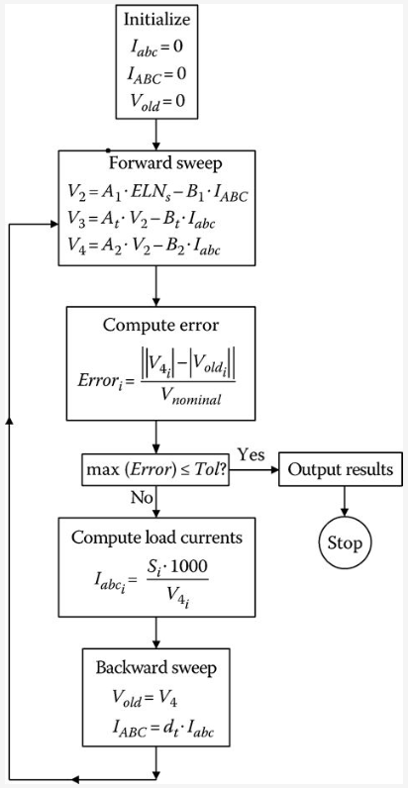
Example
The flowchart of a Mathcad® program is shown in Fig.8.
The Mathcad program is used to analyze the system, and, after eight iterations, the load voltages on a 120 V base are
V₃
$$\left[{V4}_{120}\right]=\left[\begin{aligned}113.9 \\ 110.0 \\ 110.6\end{aligned}\right] V$$
Update nodal injection currents (loads, capacitors, ….) before moving to backward sweep.
Fig.8 Flowchart
ECpE Department

Slide 25
Example
The voltages at node 4 are below the desired 120 V. These low voltages can be corrected with the installation of three step-voltage regulators connected in wye on the secondary bus (node 3) of the transformer. The new configuration of the feeder is shown in Fig.9.
For the regulator, the potential transformer ratio will be 2400–120 V (N_{pt} = 20) and the CT ratio is selected to carry the rated current of the transformer bank. The rated current is
$$I_{rated}=\frac{6000}{\sqrt{3}∙2.4}=832.7$$
The CT ratio is selected to be 1000 : 5 = CT = 200.
Fig.9 Voltage regulator added to this system
ECpE Department

Slide 26
Example
The equivalent phase impedance between node 3 and node 4 is computed using the converged voltages at the two nodes. This is done so that R and X settings of the compensator can be determined:
$${Zeq}_{i}=\frac{{V3}_{i}−{V4}_{i}}{{I3}_{i}}=\left[\begin{aligned}0.1414+j0.1830 \\ 0.2079+j0.2827 \\ 0.0889+j0.3833\end{aligned}\right] Ω$$
The three regulators are to have the same R and X compensator settings. The average value of the computed impedances will be used:
$$Z_{avg}=\frac{1}{3}∙\sum_{k=1}^{3}{{Zeq}_{k}=0.1451+j0.2830 Ω}$$
The value of the compensator impedance in volts is given as
$$R^{′}+jX^{′}=\left(0.1451+j0.2830\right)∙\frac{1000}{20}=7.3+j14.2 V$$
The value of the compensator settings in Ohms is
$R_{Ω}+jX_{Ω}=\frac{7.3+j14.2}{5}=1.46+j2.84$ $Ω$
ECpE Department

Slide 27
Example
With the regulator in the neutral position, the voltages being input to the compensator circuit for the given conditions are
$${Vreg}_{i}=\frac{{V3}_{i}}{PT}=\left[\begin{aligned}117.5∠−31.2 \\ 117.1∠−151.7 \\ 116.7∠87.8\end{aligned}\right] V$$
The compensator currents are
$${Icomp}_{i}=\frac{{Iabc}_{i}}{CT}=\left[\begin{aligned}1.6460∠−63.6 \\ 2.2727∠−179.4 \\ 2.8264∠64.9\end{aligned}\right] A$$
With the input voltages and compensator currents, the voltages across the voltage relays in the compensator circuit are computed to be
$$\left[V_{relay}\right]=\left[V_{reg}\right]−\left[Z_{comp}\right]∙\left[I_{comp}\right]=\left[\begin{aligned}113.0∠−32.5 \\ 111.3∠−153.8 \\ 109.0∠84.5\end{aligned}\right] V$$
Notice how close these compare to the actual voltages on a 120 V base at node 4.
ECpE Department

Slide 28
Example
Assume that the voltage level has been set at 121 V with a bandwidth of 2 V. In the real world, the regulators on each phase will change taps one at a time until the relay on that phase reaches 120 V. In order to model this system, the flowchart of Fig.8 is slightly modified in the forward and backward sweeps.
Forward sweep:
$$\left[{VLN}_{2}\right]=\left[A_{1}\right]∙\left[E_{s}\right]−\left[B_{1}\right]∙\left[I_{ABC}\right]$$
$$\left[{VLN}_{3r}\right]=\left[A_{t}\right]∙\left[{VLN}_{2}\right]−\left[B_{t}\right]∙\left[I_{in}\right]$$
(9.a)
$$\left[{VLN}_{3}\right]=\left[A_{reg}\right]∙\left[{VLN}_{3r}\right]−\left[B_{reg}\right]∙\left[I_{abc}\right]$$
$$\left[{VLN}_{4}\right]=\left[A_{2}\right]∙\left[{VLN}_{3}\right]−\left[B_{2}\right]∙\left[I_{abc}\right]$$
Backward sweep:
$$\left[V_{old}\right]=\left[{VLN}_{4}\right]$$
$$\left[I_{in}\right]=\left[d_{reg}\right]∙\left[I_{abc}\right]$$
(9.b)
$$\left[I_{ABC}\right]=\left[d_{t}\right]∙\left[I_{in}\right]$$
ECpE Department

Slide 29
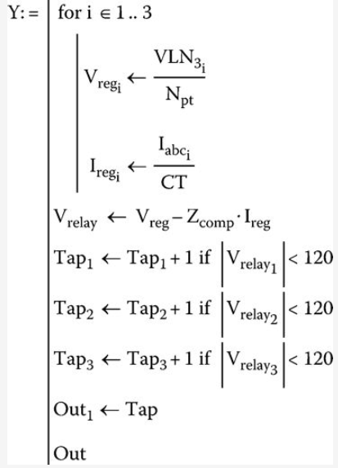
Example
After the analysis routine has converged, a new routine will compute whether or not tap changes need to be made. The Mathcad routine for computing the new taps is shown in Fig.10.
Fig.10 Tap changing routine
ECpE Department

Slide 30
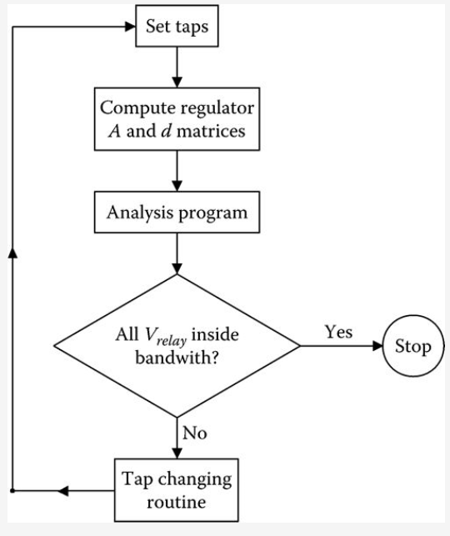
Example
The computational sequence for the determination of the final tap settings and convergence of the system is shown in the flowchart of Fig.11.
Fig.11 Computational sequence
ECpE Department

Slide 31
Example
The tap changing routine changes individual regulators one step at a time. The final tap settings are
$$[Tap]=\left[\begin{aligned}9 \\ 11 \\ 12\end{aligned}\right]$$
The final relay voltages are
$$[V_{relay}]=\left[\begin{aligned}120.3 \\ 120.4 \\ 120.1\end{aligned}\right]$$
The final voltages on a 120 V base at the load center (node 4) are
$$[{VLN}_{4_{120}}]=\left[\begin{aligned}121.0 \\ 119.3 \\ 120.7\end{aligned}\right]$$
Unlike the previous example, the compensator relay voltages and the actual load center voltages are very close to each other.
ECpE Department

Slide 32
Load Allocation
Many times the input complex power (kW and kvar) to a feeder is known because of the metering at the substation. This information can be for either total three phases or each individual phase. In some cases, the metered data may be the current and power factor in each phase.
It is desirable to force the computed input complex power to the feeder matching the metered input. This can be accomplished (following a converged iterative solution) by computing the ratio of the metered input to the computed input. The phase loads can now be modified by multiplying the loads by this ratio. Because the losses of the feeder will change when the loads are changed, it is necessary to go through the ladder iterative process to determine a new computed input to the feeder. This new computed input will be closer to the metered input but most likely not within a specified tolerance. Again a ratio can be determined and the value of the loads modified. This process is repeated until the computed input is within a specified tolerance of the metered input.
Load allocation does not have to be limited to matching metered readings just at the substation. The same process can be performed at any point on the feeder where metered data is available. The only difference is that now only the “downstream” nodes from the metered point will be modified.
ECpE Department

Slide 33
Per-unit Analysis of Power-Flow Studies
The development of the models and examples uses actual values of voltage, current, impedance, and complex power.
When per-unit values are used, it is imperative that all values be converted to per unit using a common set of base values. In the usual application of per unit, there will be a base line-to-line voltage and a base line-to-neutral voltage; also, there will be a base line current and a base delta current. For both the voltage and current, there is a square root of three relationship between the two base values. In all of the derivations of the models, and, in particular, those for the three-phase transformers, the square root of three has been used to relate the difference in magnitudes between line-to-line and line-to-neutral voltages and between the line and delta currents. Because of this, when using the per-unit system, there should be only one base voltage and that should be the base line-to-neutral voltage.
When this is done, for example, the per-unit positive and negative sequence voltages will be the square root of three times the per-unit positive and negative sequence line-to-neutral voltages. Similarly, the positive and negative sequence per-unit line currents will be the square of three times the positive and negative sequence per-unit delta currents. By using just one base voltage and one base current, the per-unit generalized matrices for all system models can be determined.
ECpE Department

Slide 34
Summary of Power-Flow Studies
This section has developed a method for performing power-flow studies on a distribution feeder. Models for the various components of the feeder have been developed in previous chapters.
The purpose of this section has been to develop and demonstrate the modified ladder iterative technique using the forward and backward sweep matrices for the series elements.
It should be obvious that a study of a large feeder with many laterals and sublaterals can not be performed without the aid of a complex computer program.
ECpE Department

Slide 35
Thank You!
ECpE Department

